Slide 1

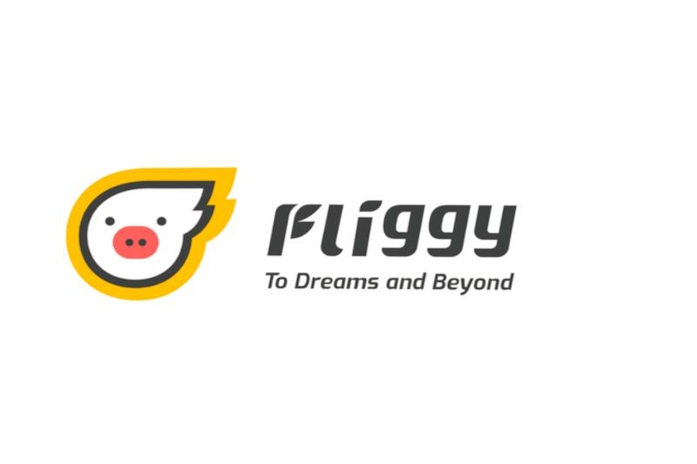

Promoting Rural Tourism
— marketing plan

Slide 2

CONTENT
1. Background
2. Business Description
2.1 Services Introduction
2.2 Company Overview
3. Environmental Analysis
3.1 SWOT Analysis
4. Marketing Objectives
5. Marketing Strategy
5.1 Objects of Marketing
5.2 Marketing mix strategies
6. Financial Analysis
7. Marketing Implementation
8. Evaluation and Control
9.Executive Summary

Slide 3


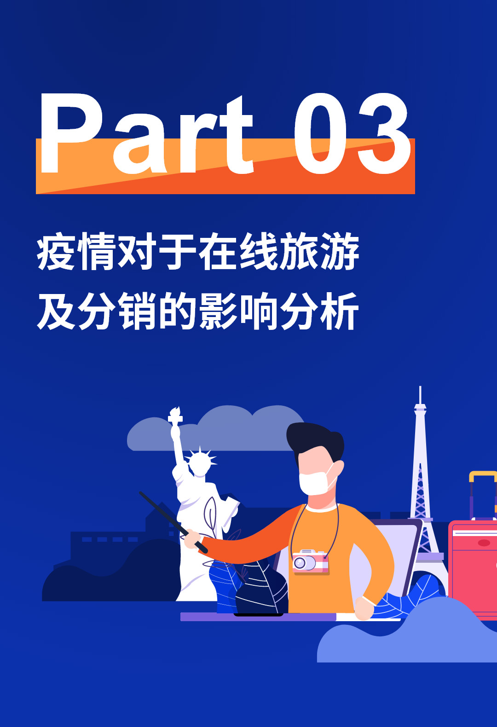

1.Market Background
Tourism revenues¹
- 69%
China‘s epidemic situation is getting better, and people who have been suppressed for a long time are eager to go out to relax. However, the vigilance developed in the past few months about the outside environment and crowd gathering has not been eliminated. Therefore, long-distance, cross-region travels will be carefully selected. Thus, the reliable and safe rural tourism around cities in the short term will be the first choice for tourists.
Tourism loss¹
$ 1000 bn
Expected number of domestic tourist in 2020¹
-56%
213
Countries, areas or territories with confirmed
covid-19 cases²
1
— 1. Established on Mar. 1, 2020 from China Tourism Academy
— 2. Data established by WHO on Apr. 23, 2020

Slide 4
2.1 Services Introduction
2. BUSINESS DESCRIPTION
Market background
The reliable and safe rural tourism around cities in the short term will be the first choice for tourists.
Goals and Objectives – brief overview of the business
To address these critical demands and build market-leading capabilities, our vision is to help Fliggy, an online travel agency, to develop rural tourism projects.
2
Notes:
Bosch aims at a strong and meaningful development, preserving its financial independence. This enables us to invest long-term oriented more than competitors and by that ensure sustainable growth. Logistics is a contributor to that objective, therefore we adopt it in our logistics mission statement.

Slide 5





2.2 Company Overview — Fliggy
2. BUSINESS DESCRIPTION
Our Brand – what we represent
A leading online travel platform in China. As a key component of the Alibaba Economy, Fliggy is committed to promoting Alibaba Group’s “Global Fun” initiative.
Our mission – what drives us
To support travelers and merchants alike by playing a central part of travel experience – not just when booking a trip, but also during the trip itself, as well as after the trip.
Our Service – what will help us succeed
Focusing on customers
We understand our travelers’ requirements.
We tailor our tourism products to them, and we create innovative tourism modes.
Shaping change of tourism industry
We enable brands and merchants to operate their own shop but provides them with marketing and data analytics support.
Striving for excellence
We provide comprehensive
reservation services for airline tickets, accommodation, train tickets, car rental, package tour and destination attractions.
Our culture – what we do well
Fantastic  Leading  inspiring  Gusty  Gifted  Young
Our values – what we build on
Your Bridge to Best Travels.
3
Notes:
Implementation of “We are Bosch”
In January 2015, G1 launched the new mission statement of Bosch “We are Bosch”.
“We are Bosch” shall create a clear common understanding of the Bosch strategy.
“We are Bosch” gives clear expression to the change the company is going through.
With the new Bosch Mission Statement “We are Bosch” we got a new input for our strategy and it was important to translate it for logistics.
[link: More information about “We are Bosch”]

Slide 6



Take SWOT Analysis As An Example
3. ENVIRONMENT ANALYSIS
Strength
Supported by Alibaba Group & inherits its great customer flow
Diversified types of tourism-related services on Fliggy
Increased PCI leads to increasing willingness to travel
The need to customize personalized travel products through big data has increased
Opportunities
Fliggy’s users source greatly rely on Alibaba products like TaoBao instead of the application itself
Fliggy is relatively young compared with other OTA platforms
Weaknesses
Threatens
4

Slide 7

In the section of rural tourism on Fliggy platform:
4. MARKETING OBJECTIVES
2019
2020¹
The plan Focus:
Working on precision marketing targeting Fliggy’s loyal members
Popularize and cultivate the rural tourism market
$20 bn
Revenue
~$50 bn
Revenue
$47 bn
Sales
>$60 bn
Sales
$21 bn
Profit
>$30 bn
Profit
5
- 1 Statistics of 2020 is expected to be achieved at the end of year 2020
Notes:
AP warehouse -26:
JP:3
KR:1
CN:~22

Slide 8
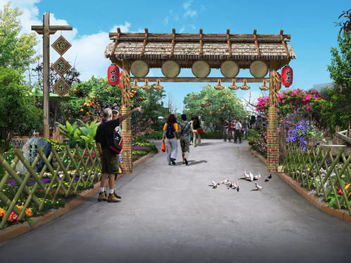
5. MARKETING STRATEGY
5.1 Objects of Marketing
Agritourism market to be targeted: Families, Friends
Participation
Relaxation
Suitable for various events
Leisure and entertainment to get rid of stress and anxiety
Connectivity
High-quality
As enabler
for kinship
and friendship
Combination of great landscape and natural food in rural areas.
6

Slide 9
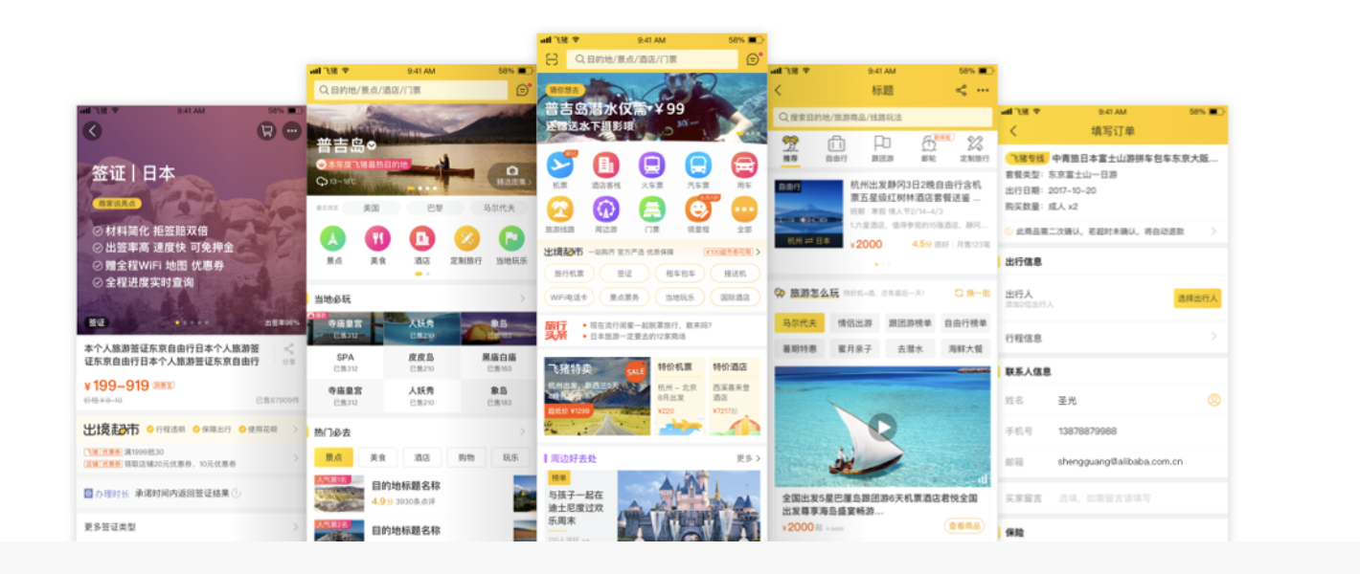
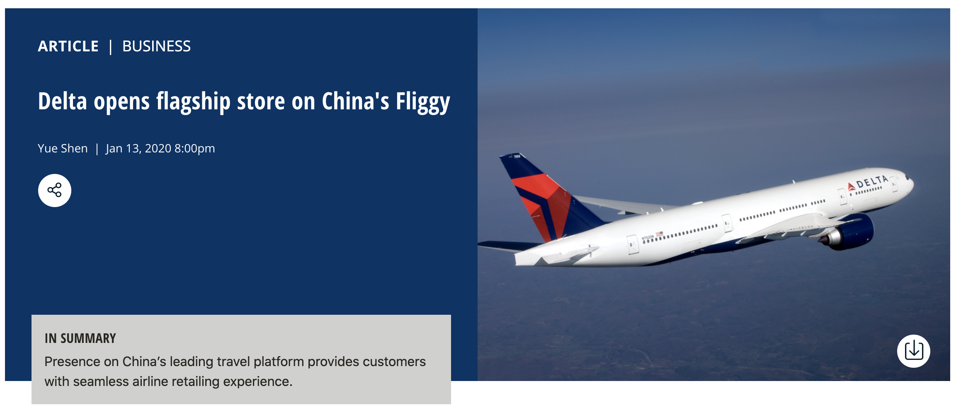
5. MARKETING STRATEGY
5.2 Marketing mix strategies
Products
Highlight the advantages of the natural landscape of the countryside, and carry out unique rural tourism to meet the aesthetic needs of tourists.
Pricing
Establish a reasonable tourism price system and design discounts strategies.
Promotion
Open flagship stores on Fliggy. Use social media platforms like twitter. Employ celebrity effect to get high reputation.
7

Slide 10




6. Financial Analysis
This year, with this promotion, Fliggy expects to sell rural tourism products for the second half of the year at $35 billion.
60 bn
+40%
47 bn
+28%
30 bn
+60%
21 bn
Website Ads & Social media promotion
6.3 bn
10 bn
$4$×$10⁹; 40%¹
2019
2020
2019
2020
2019
2020
Rural Tourism Products Sales
Profit in Rural Tourism
Marketing Budget in Rural Tourism
$10 bn
Total budget for rural tourism marketing
— 1. Data of 2019 is from analysis of Fliggy annual report.
— 2. Data of 2020 are all predict value in ideal situation
Traditional offline advertising
$4×10⁹; 40%¹
SMS & Email marketing
$2×10⁹; 20%¹
8
— Share of total marketing budget

Slide 11




7. Marketing Implementation
Enter Phase
Executing Process
Evaluation Phase
By June to launch pilot of few selected locations.
By August to full launch for all platforms on Fliggy.
By November to provide support and maintain the farm tourism market.
9

Slide 12

8. Evaluation and Control
From the risks …
… to the solutions
Business
requirements risk
Price risk
Credit risk
Search engine index
or
Social media index
Analysis of feedback and comments from clients
Changes in agritourism products sales
Promotion strategy evaluation
Identification of direct changes resulted from the marketing
Improve the design of marketing plan
10

Slide 13

Thanks for watching！ YIJING TAN MS-MITA 04.2020

